Slide 1
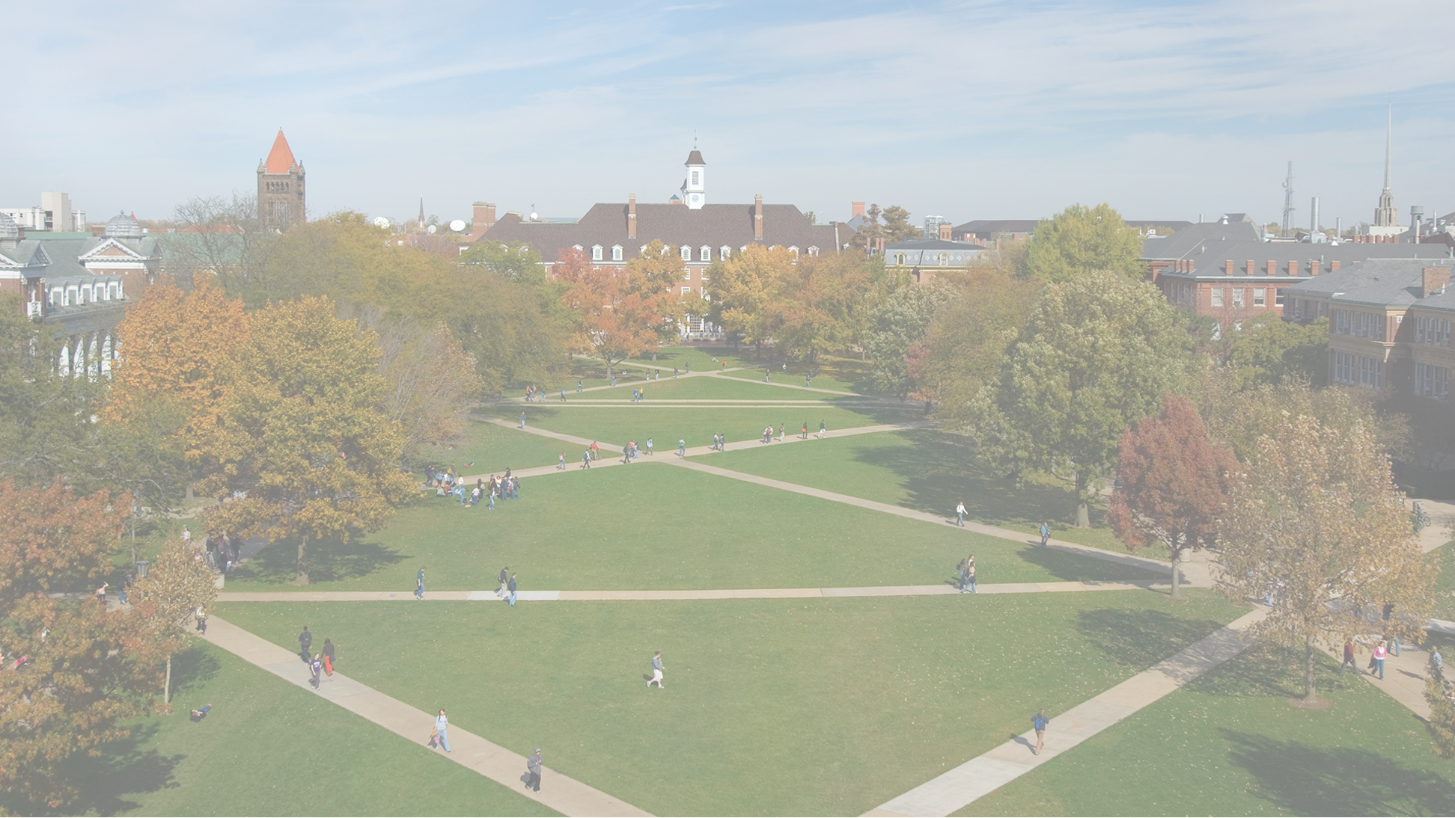


Instacart Market Basket Analysis
Ayushi Sharma
Zach Zoloto

Slide 2
The Process
Customer Flow
Customer Registers for Instacart
Input payment information, location, and basic preferences
Select a local store, groceries and any special instructions
Output: Shopper receives order
Shopper selects groceries and delivers to customer
Customer has option to add tip, review shopper/experience
Flexibility to re-order at your convenience! (Automated or in-app)

Slide 3
The Brand
Customers are everything!
Reliable, convenient, and efficient service
"Grocery first, but not grocery only"
Partner with retailers
Help shape customer experience, offer sales and support growth strategies
Community - Building connection in the virtual grocery experience

Slide 4
The Mission
"Create a world where everyone has access to the food they love."
Three Pillars:
Service, Accessibility, and Convenience
As Instacart scales, maintaining sense of community is essential
Leverage scale and quality to connect with customer desires
Evolving Brand Image

Slide 5
The Marketplace
Crowded and Growing
Notable Competitors:
UberEats, DoorDash, Grubhub, HelloFresh, Blue Apron
Carve out strategic advantages to create long-term value
Important Consideration: What competitive advantage best suits Instacart now and in the future?
Niche customer base?
Cost Leader?
Brand Strength?

Slide 6
The Problem
Marketplace is evolving rapidly!
Competitors beginning to scale and adjust their strategy
Customer preferences evolving -- convenience is no longer unique
How can Instacart evolve while maintaining core values?

Slide 7
The Business Solution
Leverage analytical tools to better understand and connect with customers
Understanding customers will:
Provide more recurring users
Add additional order volume
Improve user experience
Direct future growth strategies
Strengthen partnerships with retailers

Slide 8
The Areas of Opportunity
Strengthening Customer Recs
Understanding customer orders, product groupings and product volume
Understanding macro-level demand flow
When are products ordered (Week and Time-of-Day)
Are products ordered from recipes? Are customers consistently ordering at the same times? How many shoppers do we need to meet demand?

Slide 9
Our Approach to the Problem
Some key questions guiding our approach include:
Can we predict the number of transactions at a given time?
How many shoppers do we need to properly meet demand?
Can we use logistic regression to predict whether a product will be re-ordered?
Can we predict locations of products/groupings for customers at a given time of the day?
Can we predict what a customer wants based on items in their cart?

Slide 10
Who Does This Benefit?
Customers
Better immersive user experience
Enhanced app capabilities, personalized interface and ability to see trends
Retail Partners
Better understanding of customer preferences, order volume, and supply-chain optimization
Instacart
Strengthening long-term strategic advantages
Driving revenue growth, optimizing processes, and strengthening partnership value

Slide 11
Analytics Approach
Descriptive Statistics – Understanding our dataset, general trends about customers
Association Mining (Apriori Algorithm)
Applied to products as a predictor of customer preference
Linear/Logistic Regression
Applied to product and customer-specific data

Slide 12
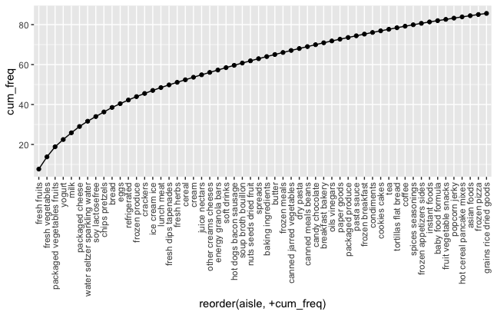
Descriptive Statistics
31% of all the products purchased via Instacart are from 7 aisles – fresh fruits, fresh vegetables, packaged veggies/fruits, yogurt, milk, cheese and sparkling water
80% of all the products purchased come from 47 aisles i.e., 35% of total aisles
80%
% of purchases
31%
Aisles

Slide 13
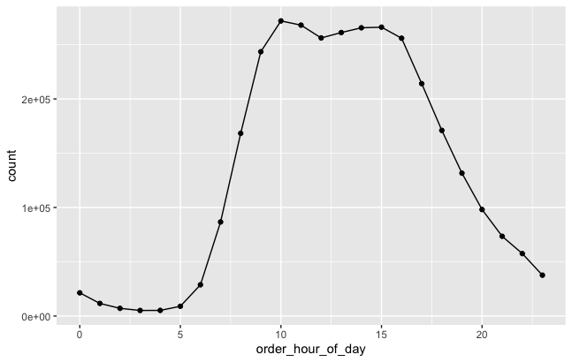
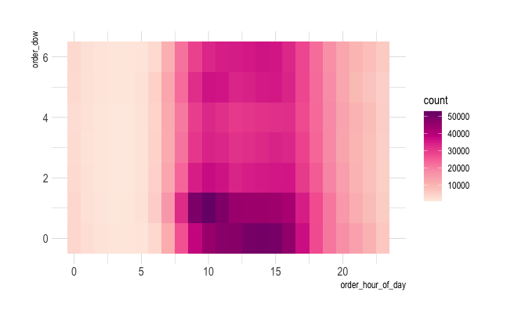
34%
82%
Count of orders
Day of the week
Hour of the day
Hour of the day
34% of all Instacart orders are placed by 11 a.m., whereas 82% of all orders are made by 5 p.m.
Sunday and Monday account for 34% of weekly orders. By Tuesday's end, Instacart's order volume approaches 50%.

Slide 14
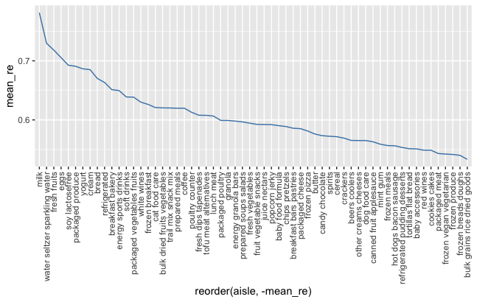
There are four aisles that have a greater than 70% rate of reordering- milk, fresh fruit, sparkling water and eggs.
With a volume of 3.4%, milk is reordered 78% of the time, whereas fresh fruits with a volume of 7.6% are reordered 70% of the time.
Average reorders
Aisles

Slide 15
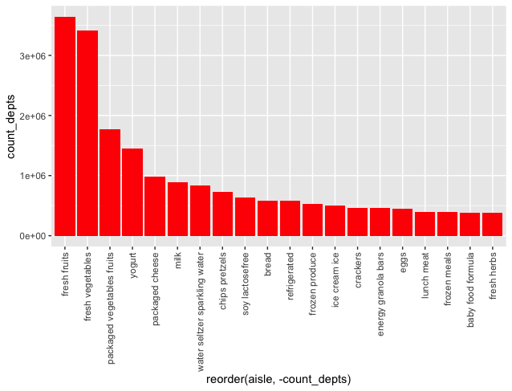
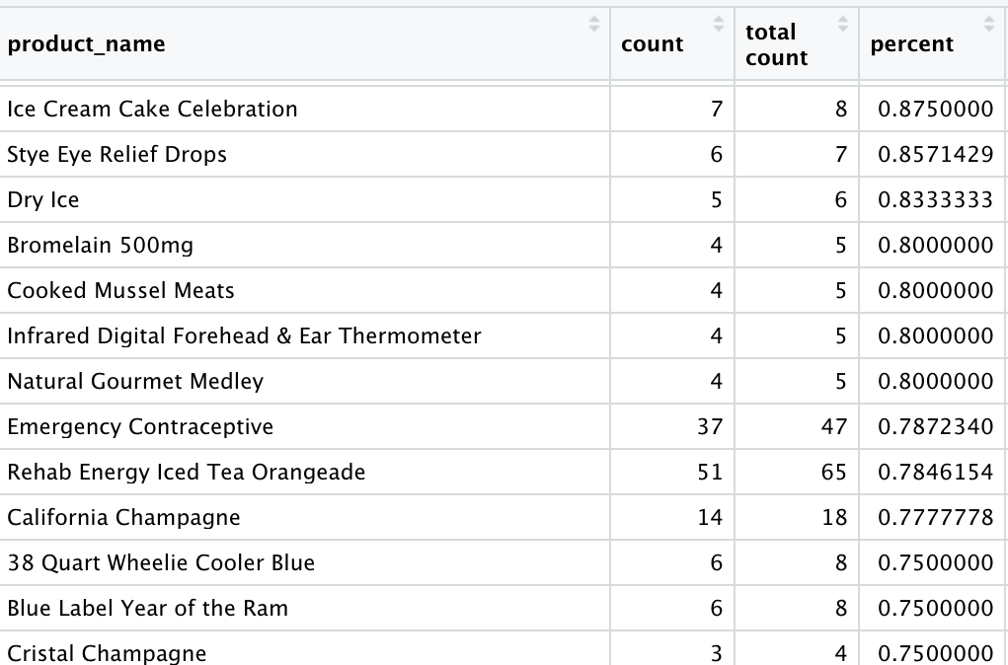
Which item do people put into the cart first?
Maximum number of the times, products from the fresh fruits, fresh vegetables, packaged veg/fruits and Yogurt aisles are placed in the shopping cart first
From the 52% of the total orders from the Fresh fruits' aisle, it is added to the cart first about 25% of the times.
Count
Aisle names

Slide 16
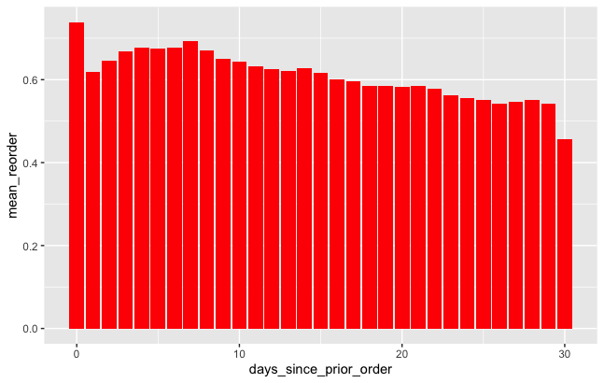
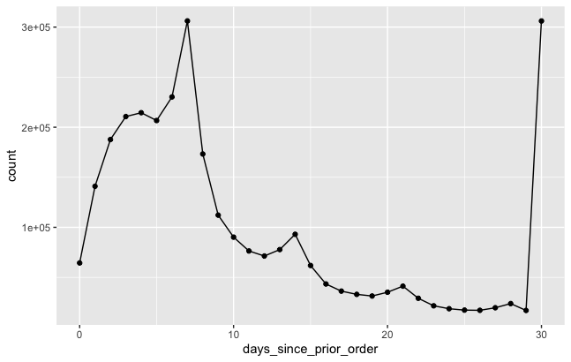
Association between time of last order and probability of reorder
Average reorder
Days since previous order
Days since previous order
If people order again on the same day, they order the same product more often. Whereas when 30 days have passed, they tend to try out new things in their order
Users purchase from Instacart more often on the 7th day, 14th day, 21st day and 31st day of the month

Slide 17
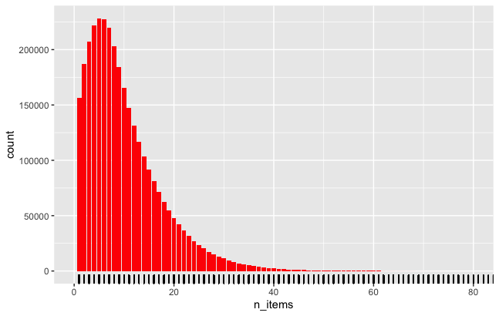
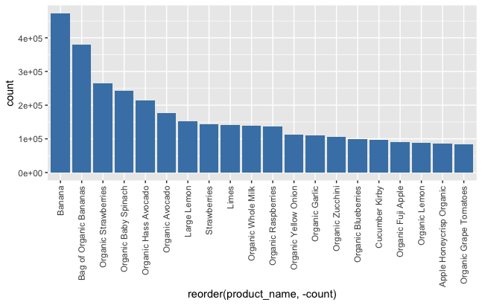
Basket Size Analysis
Total: 34,21,083 baskets, 3,24,34,489 items
Item frequency
Product names
Our basket size ranges from 2 items to 5 items
Similar products like avocado and hass avocado or strawberries and organic strawberries that we may want to group together.

Slide 18
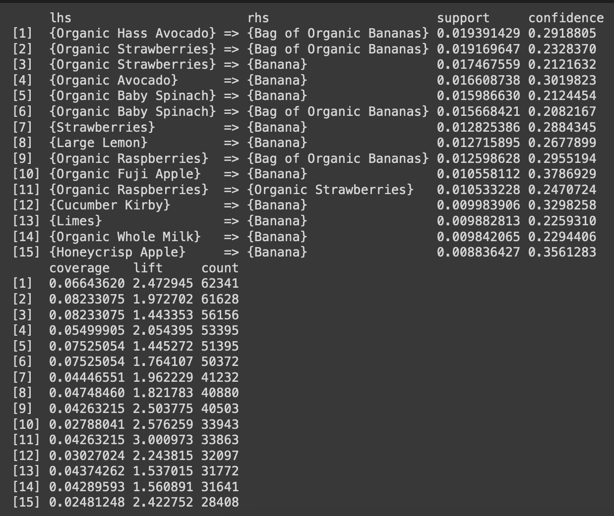
Association Mining: Rule 1
Support – 0.008 and confidence – 0.2
Each of the 15 pairs with highest support contains bananas. Nearly all of the items are either fruits or vegetables. There is just one frequent pair that contains milk (of course, with bananas)

Slide 19
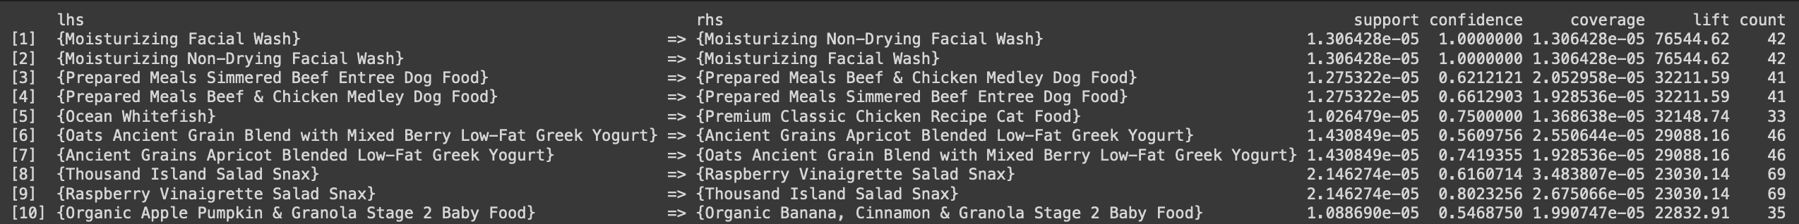
Association Mining: Rule 2
Support – 0. 00001 and confidence – 0.5
Low support threshold and a high confidence to generate strong rules even for items that are less frequent
Seems like those rules mostly affect similar items which were usually bought together.

Slide 20
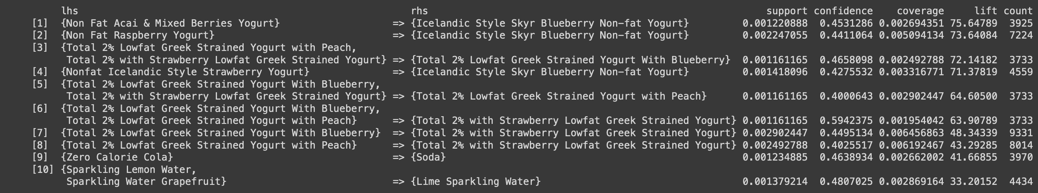
Association Mining: Rule 3
Support – 0. 001 and confidence – 0.4
Increase the support and decrease confidence to get rules of some more frequent items but with less confidence.
Now we see some yogurts, fruits and drinks which were often bought together.

Slide 21
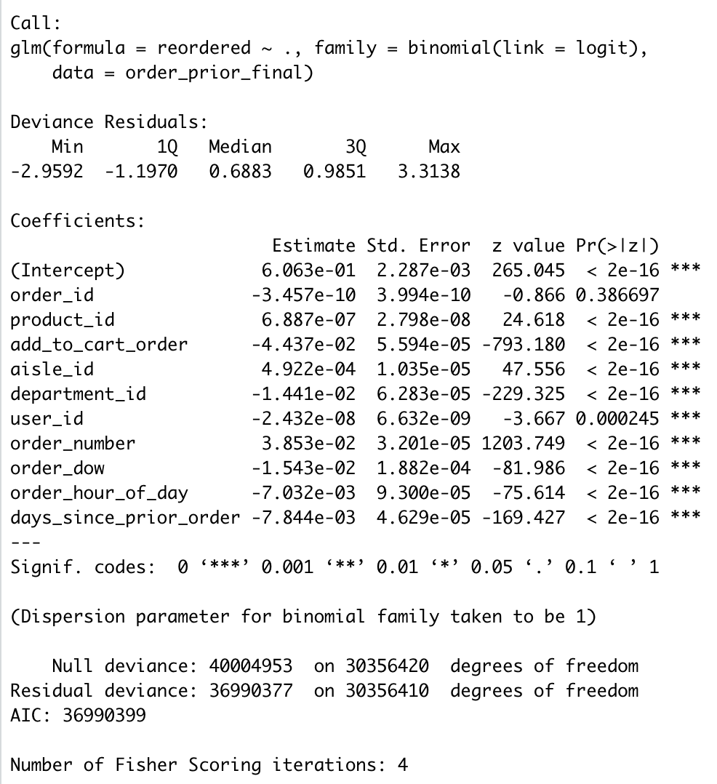
Prediction: Logistic regression
Can we use logistic regression to predict whether a product will be re-ordered?
Using all the relevant predictors we can create a model to classify whether a product has chances to be reordered.
Using Logistic regression over a training dataset of size (30356421 X 11 ) our accuracy rate calculates as 65%

Slide 22
Recommendations
Push automated product reorders!
Adjust customer recommendations to reflect item reorder probability
Create a "featured" items list based on purchasing habits
Increase interactivity and customer engagement
Adjust shopper hours to reflect purchase volume
Sunday & Monday from 10:00 AM –3:00 PM

Slide 23
Evolution of Instacart
New business strategies
Growth-focused mindset
Benefit of "Automated" Subscription Model
Instacart as an everyday essential
Thanks for listening! We'd be happy to answer any questions you have.

